Slide 1
The Listener
WDI Project 2
Seán Neale

Slide 2
Aim
Apple’s Podcast app is dull and text based
Don’t need to see that much text, I subscribe to it because I like it.
I want to build a more visual podcast app, that makes the most of the artwork that each podcast has

Slide 3
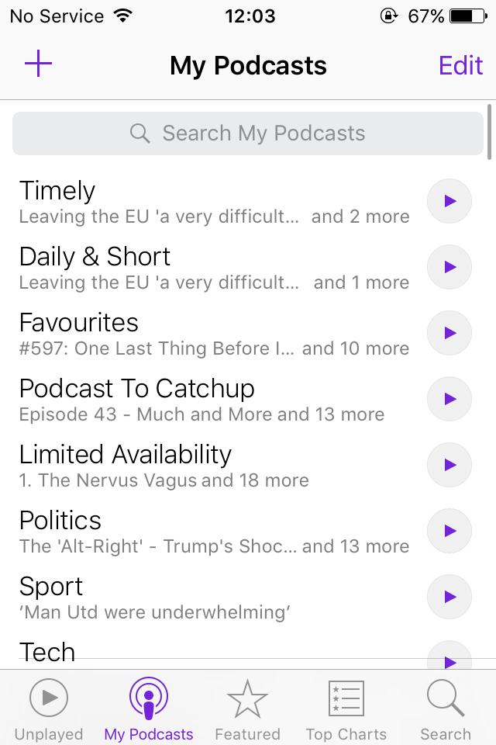

Slide 4
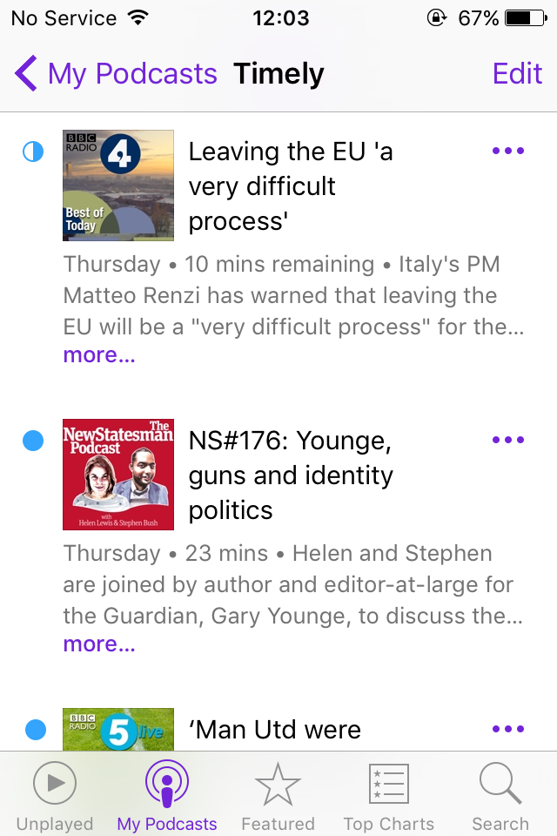

Slide 5
Collections

Slide 6
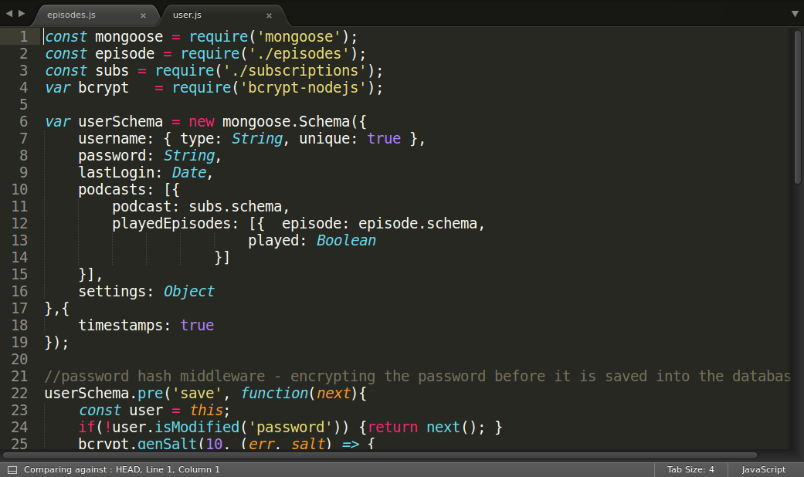

Slide 7
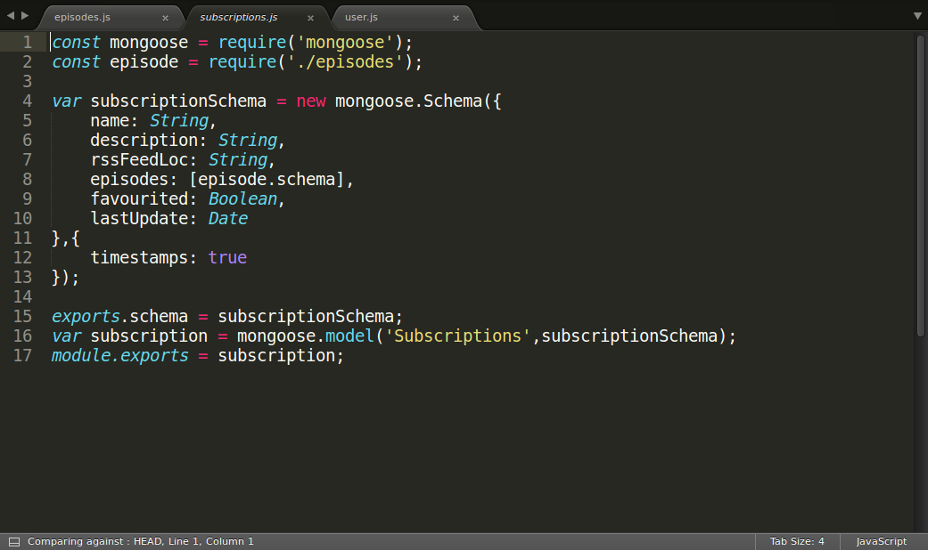

Slide 8
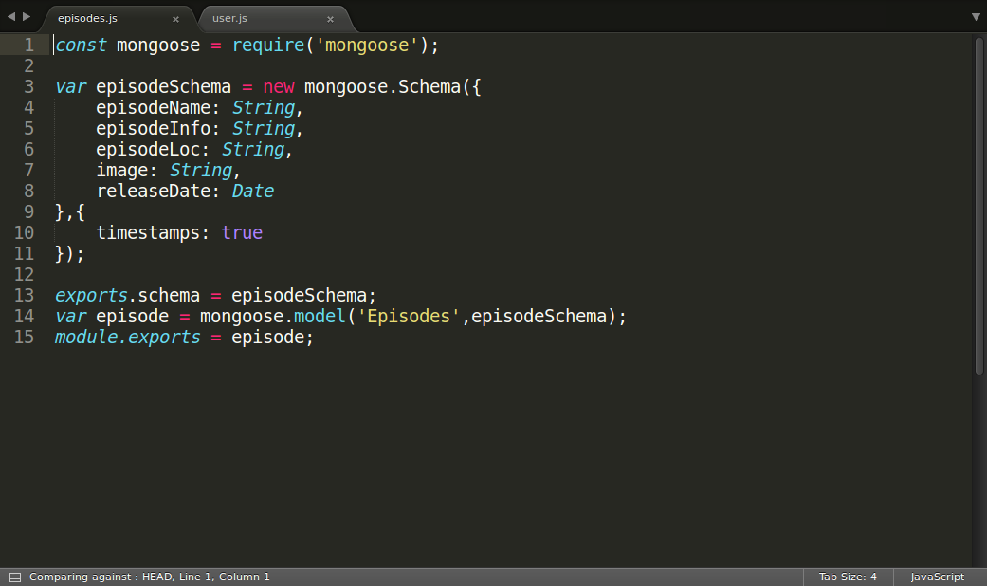

Slide 9
Technology
HTML, CSS and JS for the website
MongoDB for the database
Node.js for the server, with the following middleware
  Express - web app framework
  Passport – user sign up/login/logout
  Feed Parser – turns an RSS feed into discrete Objects
  Mongoose – interaction between DB and server
  Also, used flash, cookie-parser, body-parser and session-express

Slide 10
Targets
Add a new subscription
Play an episode
Mark an episode as played/unplayed (sort of)
Remove a subscription
Logout
Change the podcasts displayed on screen based on user choices
Automatically updating the user with new episodes as they become available

Slide 11
Successes
Planning, only 2 things needed to be added to the collections originally planned, features were also easily sorted into priorities
The design of the site and code climate scores are improved from last time

Slide 12
Failures
Small features that could’ve been implemented were not:
  Marking individual epsiodes as played
  Displaying episodes by subscription/most recent/since last login etc
New epsiodes not being automatically sent to user, not completed
Code not refactored as I completed it

Slide 13
What Next?
Complete the episode update function
Add small features
Add a search box

